Slide 1
Interpretable Machine Learning in Precision Medicine
Su-In Lee
Paul G. Allen School of Computer Science & Engineering
University of Washington, Seattle
Notes:
Thank you for the introduction.
Today, I’m going to talk about my group’s… [next page]

Slide 2

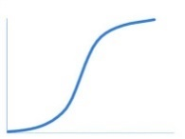

What current machine learning (ML) can do for precision medicine
ML model
Patient
Outcomes Y
Features X
X₁
X₂
:
X_{p}
-
-
-
Demographic
data
Clinical
data
Laboratory
data
End stage renal disease (ESRD)
$$f(.)$$
Kidney function
Y
Kidney failure –
Either dialysis or transplantation is required.
Time
Why?!
Why?!
AI magic!
Molecular
data
patient
doctor
ML researcher
Notes:
These days, in medicine, we use ML in pretty much the same way.
For each patient, we obtain a set of features, and use a ML prediction model to produce a prediction of a clinical outcome.
[wait]
Obtaining such a model is quite easy these days. Anyone, even elementary school students, can download ML tools and fit the models to your training data such that you have a good prediction result.
Now, then is my job done here, as an AI researcher? [pause]
When we face a prediction result like this in a clinical setting, a natural question is “why” but the model doesn’t explain.
Even the ML expert who developed the system will say “it’s AI magic. Trust it”

Slide 3
What current ML cannot do for precision medicine
ML model
Patient
Outcomes Y
Features X
X₁
X₂
:
X_{p}
-
-
-
Demographic
data
Clinical
data
Laboratory
data
Kidney function
End stage renal disease (ESRD)
Y
Time
Interpretability is sometimes more important than accuracy.
Why selected features make sense?
Which features contributed to the prediction and how?
Molecular
data
Notes:
An important missing piece here is the explanations.
For example, it doesn’t tell you
Which features contributed to the prediction.
Why the features used by the model make sense at all.
These explanations are important because they can give us information about appropriate clinical actions.

Slide 4



Interpretable ML for precision medicine
Black Box
ML model
Patient
Outcomes Y
Features X
X₁
X₂
:
X_{p}
-
-
-
$φ_{1}(f,x)$
?
Demographic
data
Clinical
data
Laboratory
data
Kidney function
End stage renal disease (ESRD)
Y
$φ_{p}(f,x)$
Time
1. Make prediction with explanations.
Individualized explanations can engender trust on the prediction result and reveal novel risk factors.
Molecular
data
Lundberg and Lee. NIPS (2017) – Oral presentation (top 1%)
NIPS workshop on Interpretable ML (2016) – Best paper award
Lundberg et al. Nature BME (2018) – Featured on the cover
Notes:
This led me to identify the following two problems we need to address to advance the field:
First, we need to be able to make interpretable predictions from complex, black-box models, such as deep learning or ensemble models.
To do that, we may estimate the importance of each feature on a particular prediction so we can reveal individualized risk factors and their interactions.

Slide 5
Interpretable ML for precision medicine
ML model
Patient
Outcomes Y
Features X
X₁
X₂
:
X_{p}
-
-
-
Demographic
data
Clinical
data
Laboratory
data
Kidney function
End stage renal disease (ESRD)
Y
Time
1. Make prediction with explanations.
2. Learn interpretable feature representation.
Pre-select or learn features likely relevant to Y.
Molecular
data
Lundberg and Lee. NIPS (2017) – Oral presentation (top 1%)
NIPS workshop on Interpretable ML (2016) – Best paper award
Lundberg et al. Nature BME (2018) – Featured on the cover
Lee*, Celik*, et al. (2018)
Nature Communications
Notes:
Second, we need to pre-select or learn interpretable features to begin with, the features that are likely to give meaningful explanations of outcomes, based on prior knowledge.
When we use time-series data, we need to somehow transform them into a form which a ML model can take as input features. Then, we want these transformed features to be relevant to the prediction tasks and still be interpretable.
Sometimes, we need to deal with the situation where not all features are collected at the same time.
For example, for a trauma patient, some from dispathchers come first, some from paramedics in ambulances or emergency rooms next, and some are measured later.
Is it possible to guide paramedics and ER doctors what need to be measured based on what is available now.

Slide 6
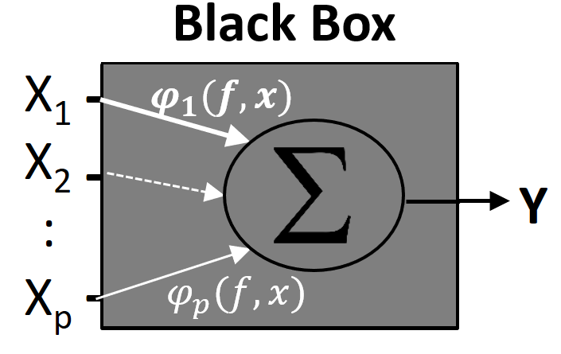
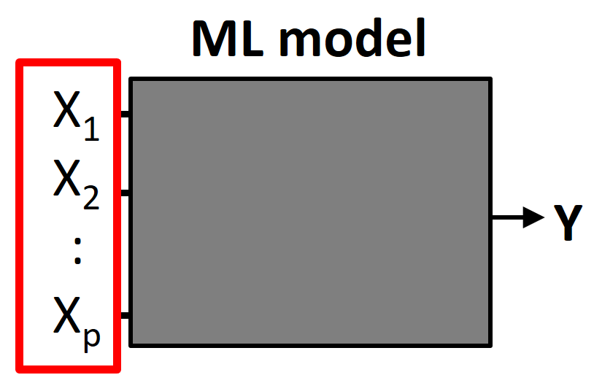
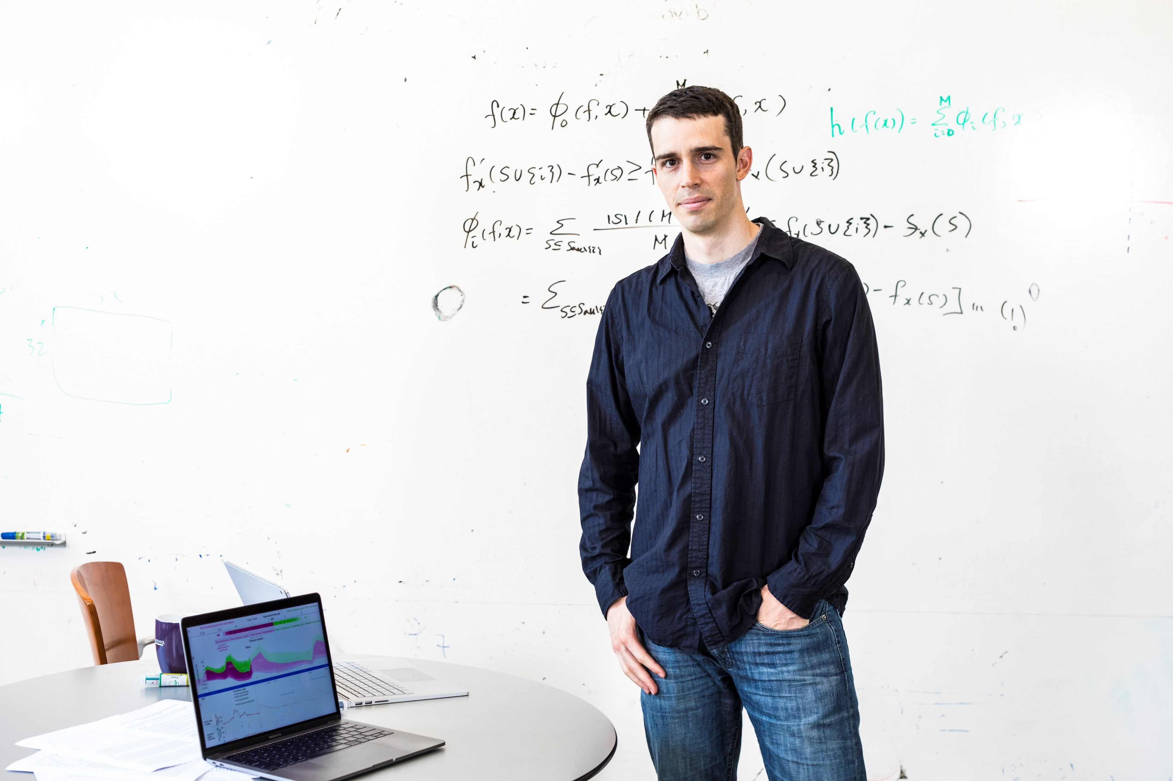

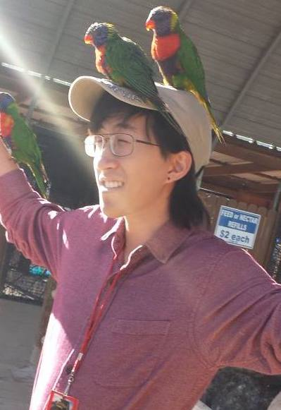
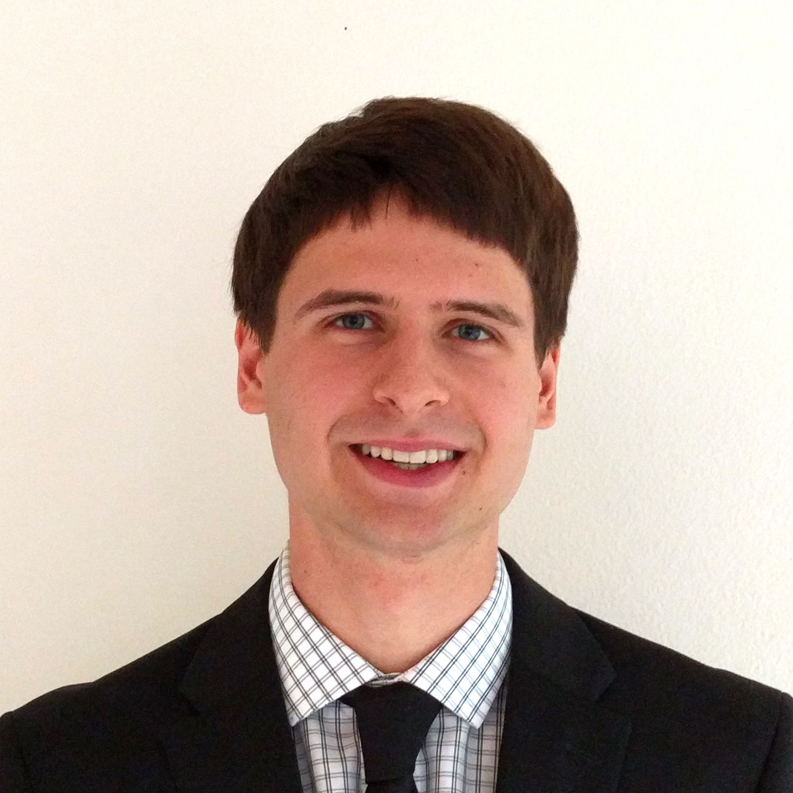
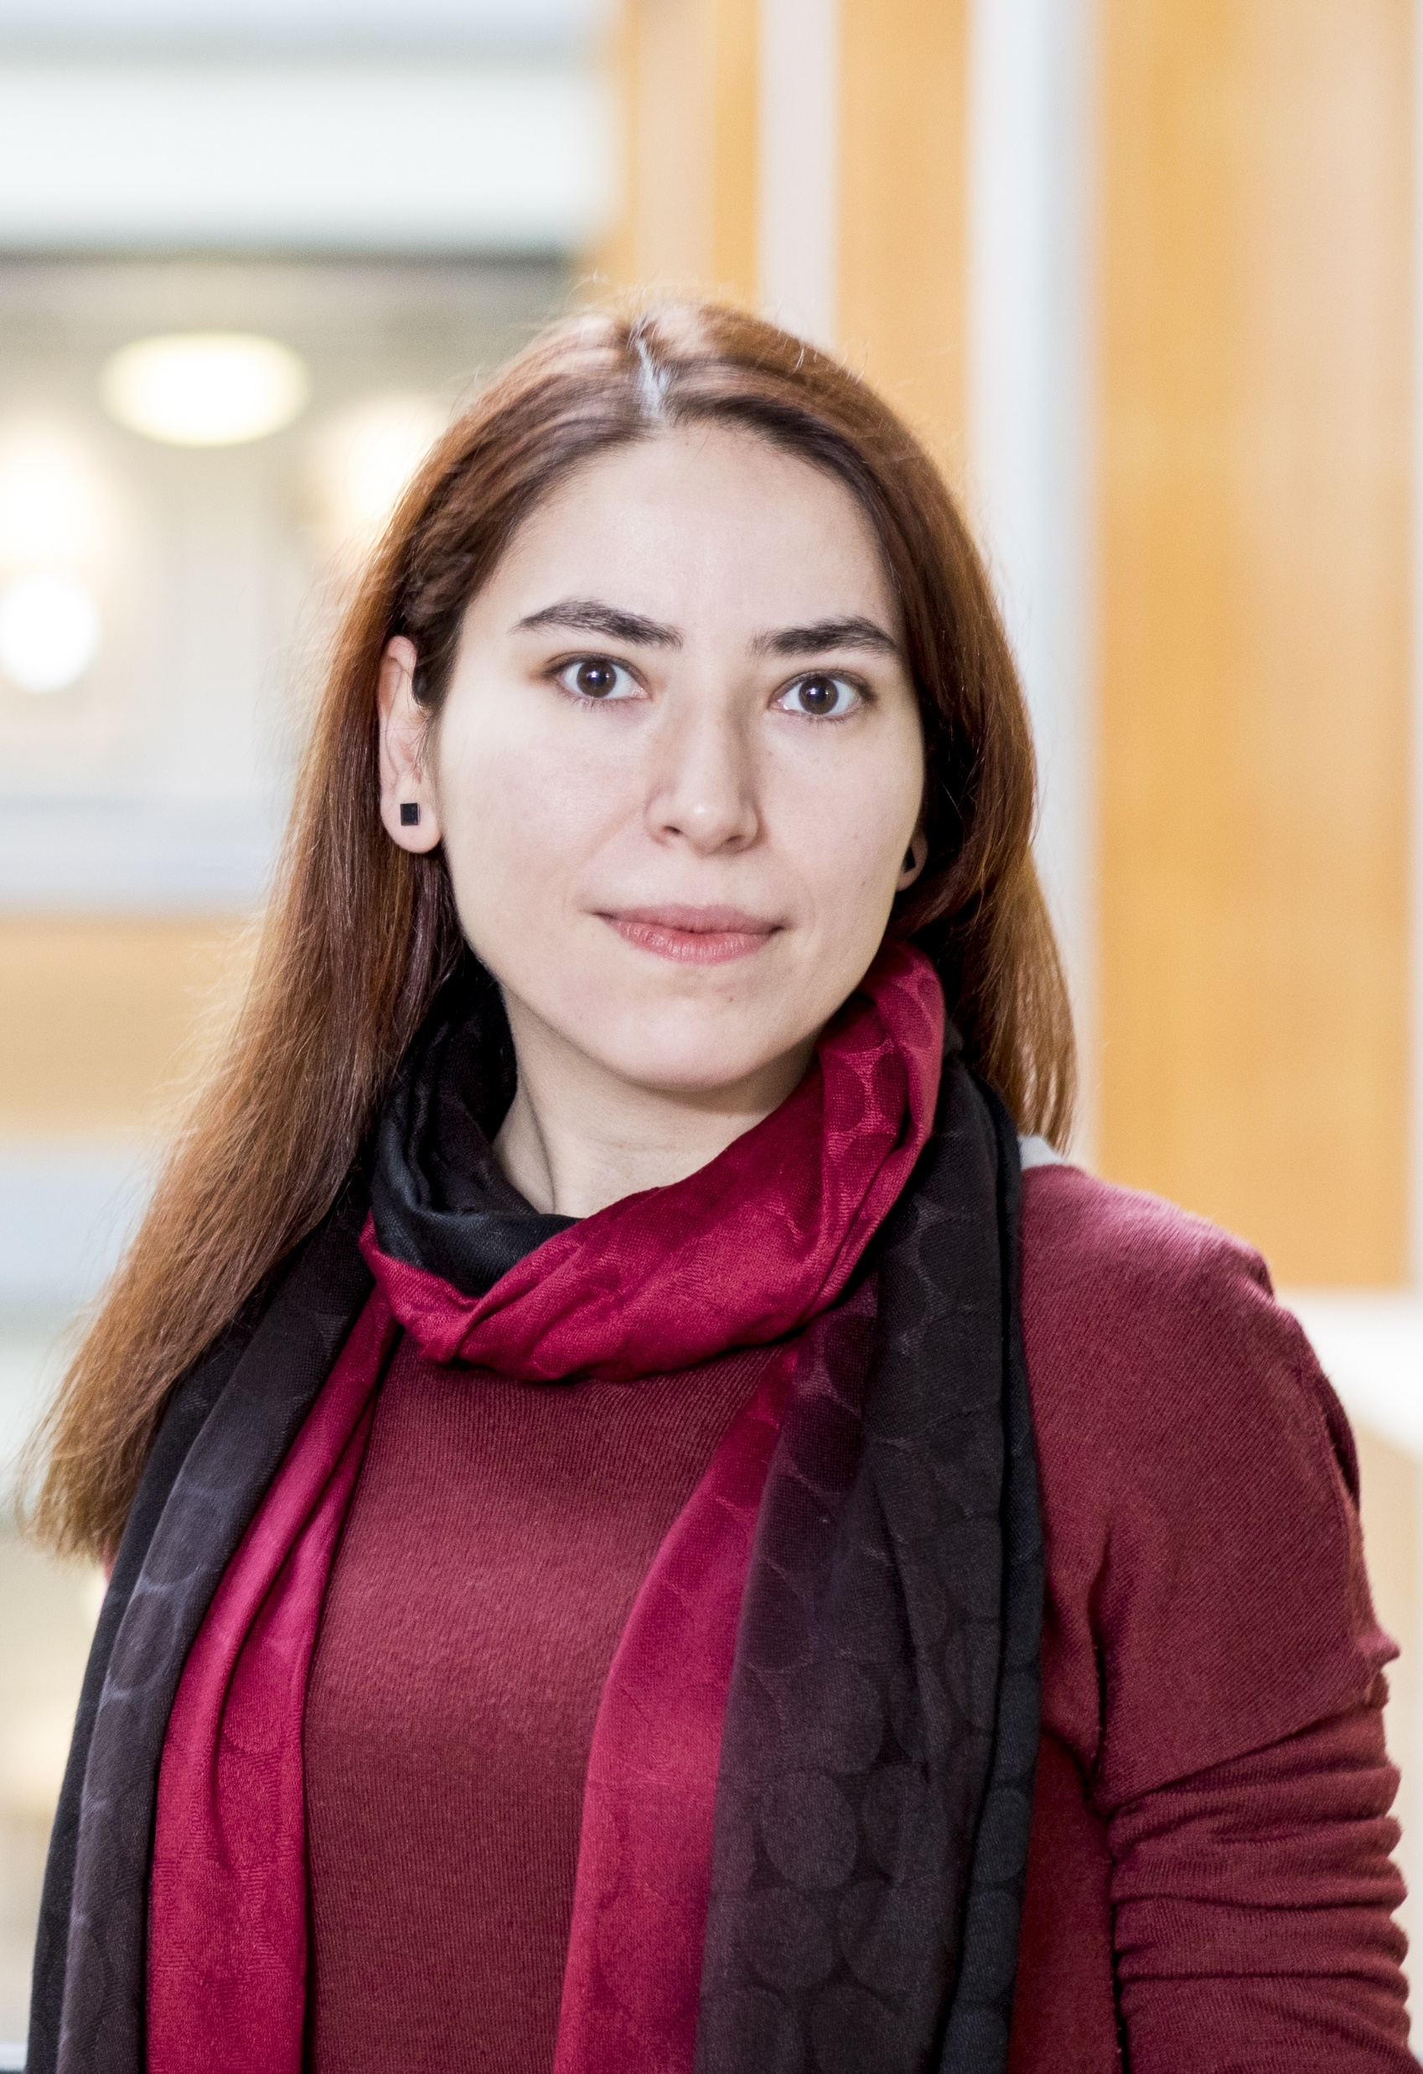
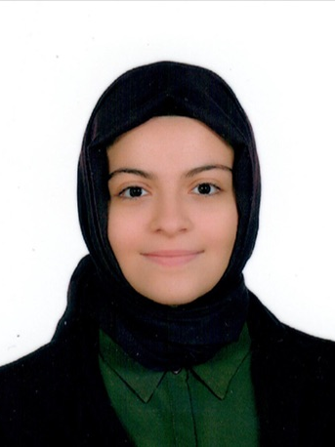



Interpretable ML can transform important areas of medicine
Prediction & decision support systems in hospitals
Make interpretable predictions from complex models.
Cancer precision medicine a
Learn interpretable feature representations.
Alzheimer’s disease therapeutic target discovery
Integrate data sets for statistical power and interpretability.
General ML techniques
Data integration
Bedside applications
Basic science
Notes:
In this talk, I am going to show you how our new interpretable ML techniques (motivated by these questions) can potentially transform important areas of medicine.
First, developing prediction and recommendation systems in hospitals;
Second, enabling personalized drug selection for individual cancer patients based on their expression data;
Finally, we are focusing on much more poorly understood disease, Alzheimer’s disease, for which there aren’t any drugs at all, so the main goal is to leverage all of the data to find a molecular basis common to general AD, which will inform drug discovery.
The techniques we are developing are mostly general and can be applied to other problems (not domain specific). And, you will see that it’s a very powerful approach.
Our research covers the spectrum from basic drug discovery for a poorly understood disease to very specific treatment recommendations for better understood diseases.
Let’s talk about the first part.

Slide 7
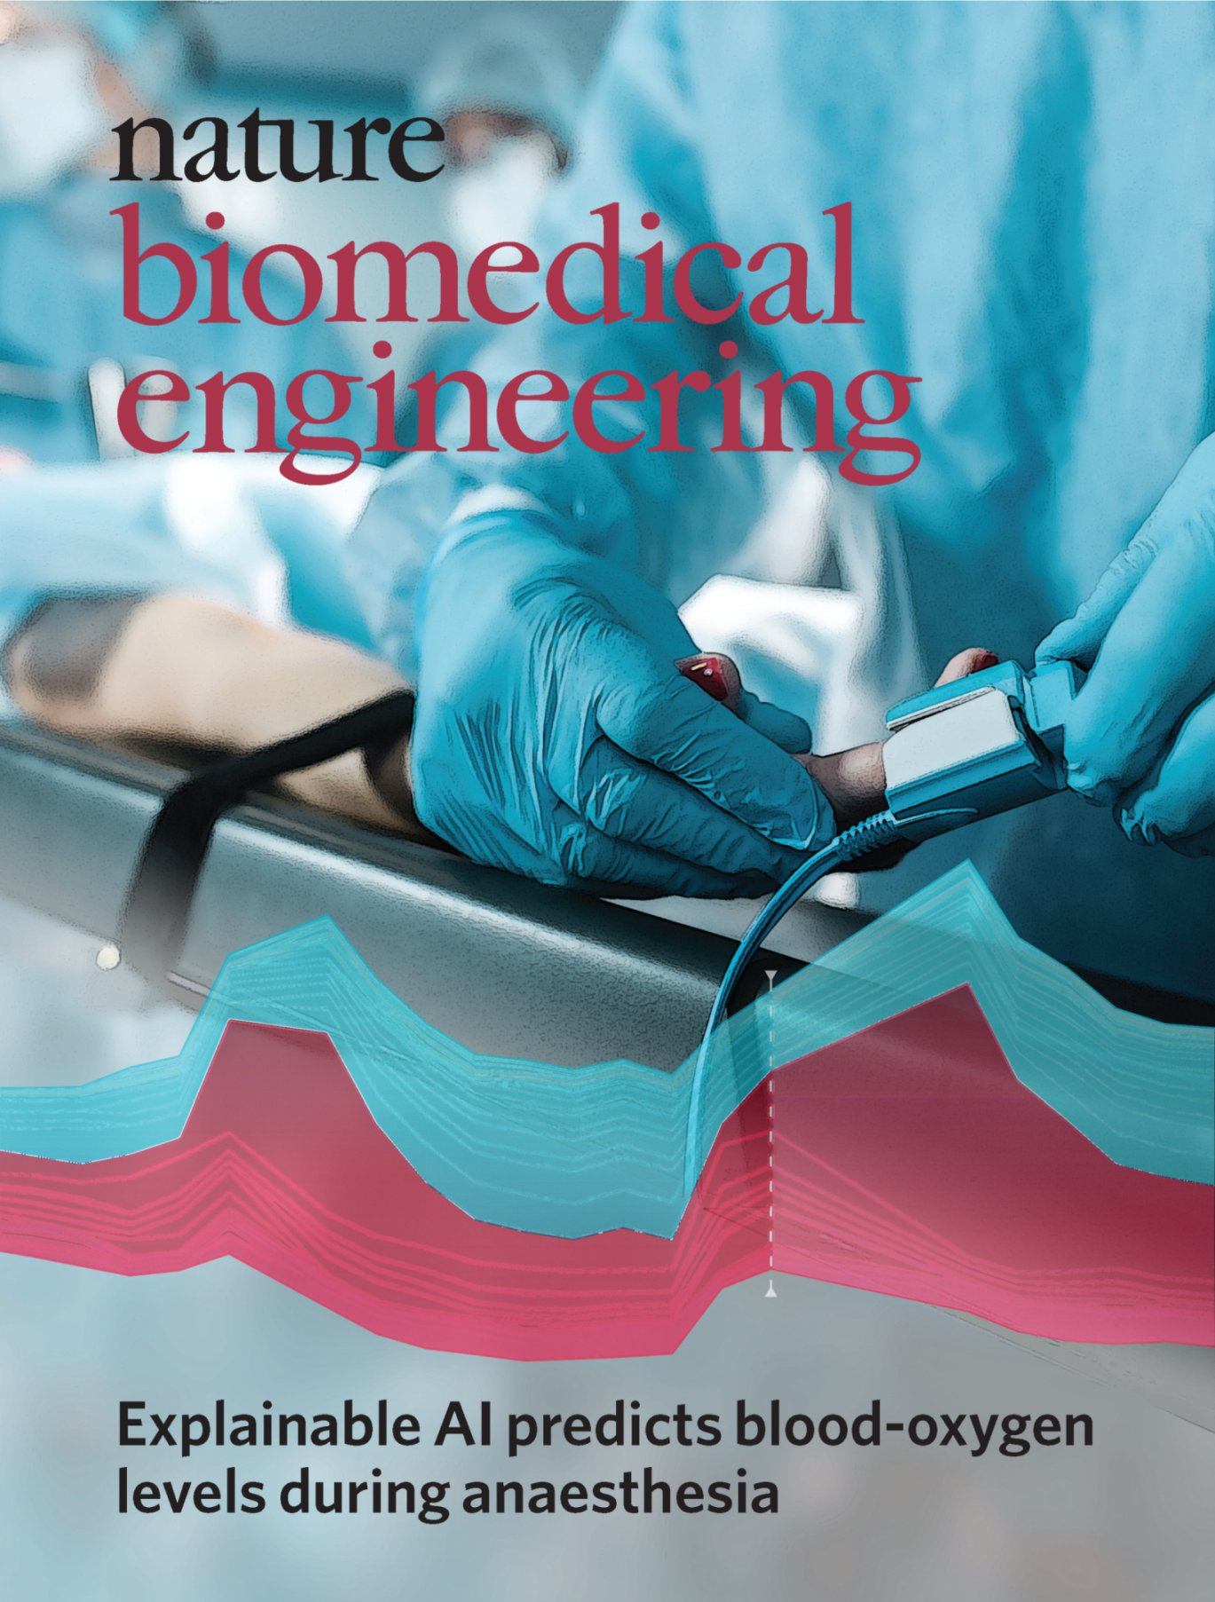
The operating room is a data-rich environment
Over 200 million surgeries every year
Hypoxemia (i.e., low arterial blood oxygen tension)
The drop in SpO2, i.e., arterial blood oxygen saturation as measured by pulse oximetry, to 92% or lower
Predicting hypoxemia events in advance would allow proactive intervention.
We developed the Prescience system that can predict hypoxemia in the next 5 minutes in real time.
Scott M. Lundberg, Bala Nair, Monica S. Vavilala, Mayumi Horibe, Michael J. Eisses, Trevor Adams, David E. Liston, Daniel King-Wai Low, Shu-Fang Newman, Jerry Kim, and Su-In Lee. Explainable machine-learning predictions for the prevention of hypoxaemia during surgery. Nature BME 2, 749–760 (2018) - Featured on the Cover
Notes:
Surgery and anesthesia are an integral part of healthcare, but pose considerable risk of complications and death.
In this project, we focused on an unwanted physiological condition called hypoxemia, meaning low blood oxygen level, that causes serious patient harm. (Leading cause of anesthesia related death during surgery)
If hypoxemia can be predicted before it occurs, then anesthesiologists can take actions to proactively prevent hypoxemia and minimize patient harm.
For that, we developed a ML technique, named Prescience, that predicts the near-term risk of hypoxemia during surgery and explains the factors that led to that risk. So, how does it work?

Slide 8
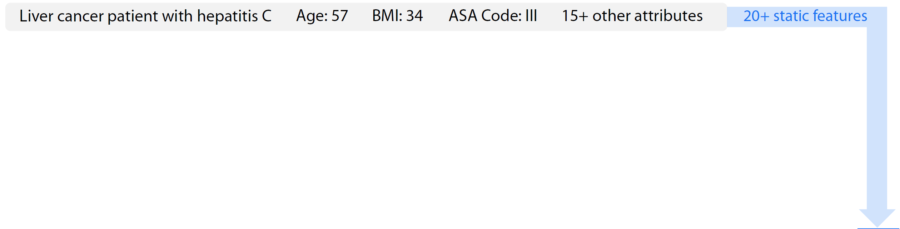
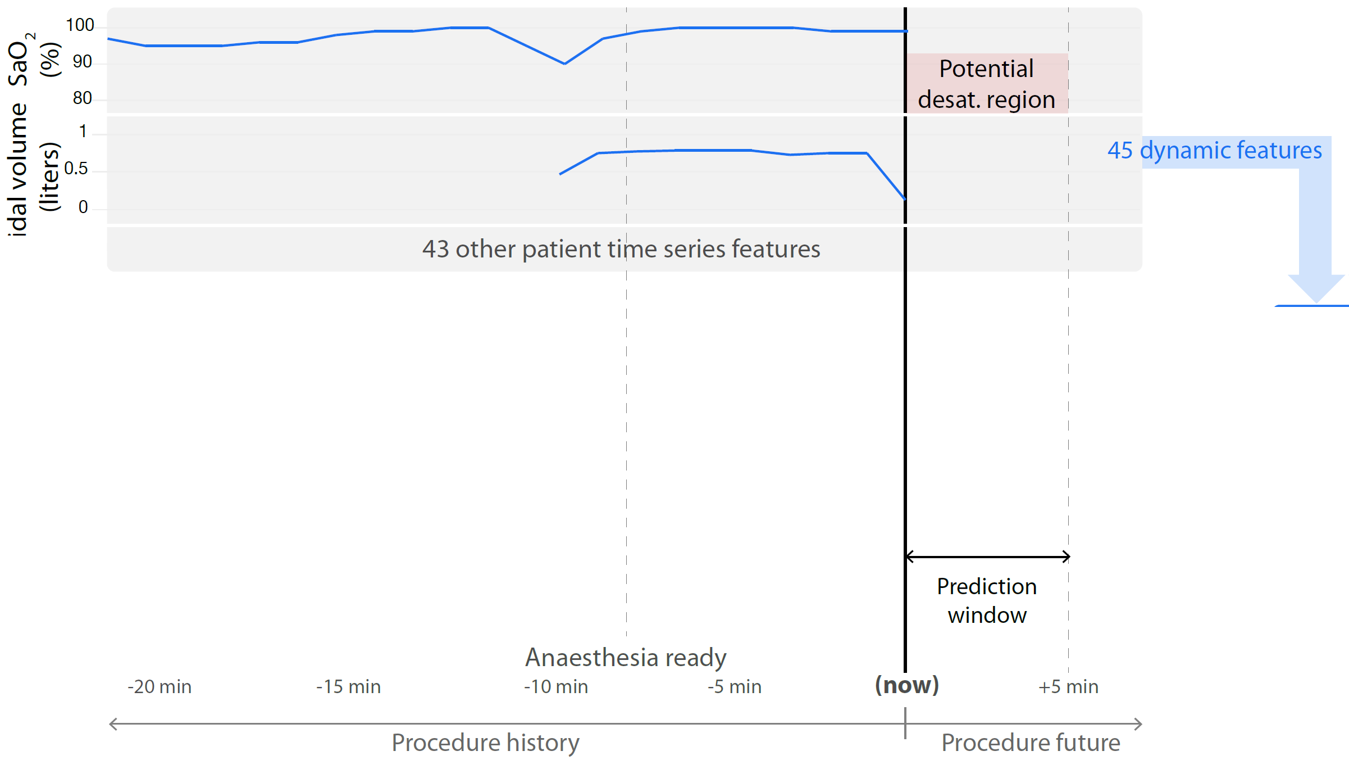
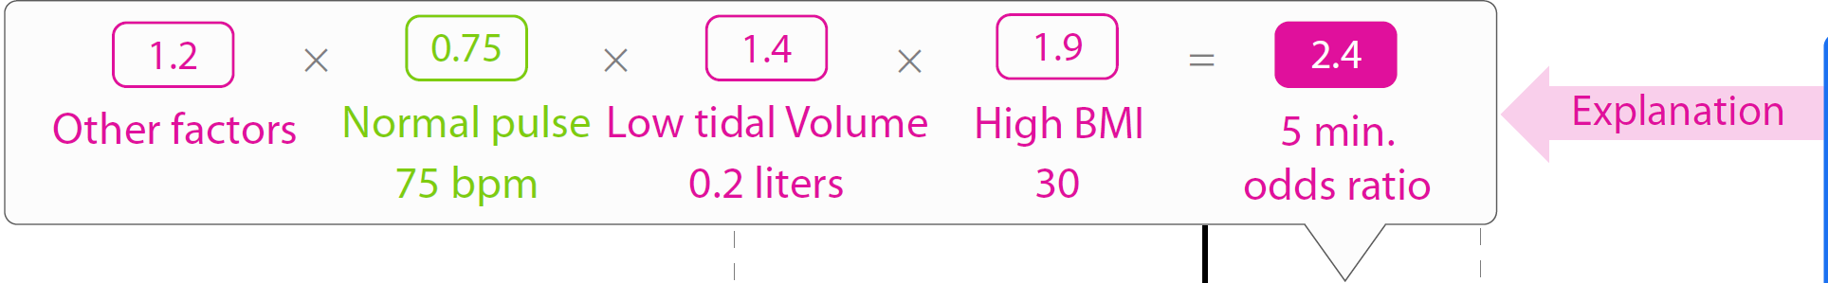
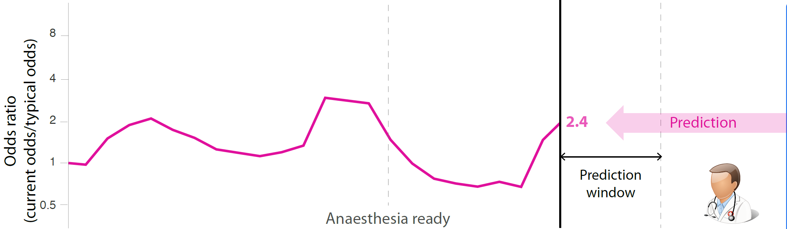
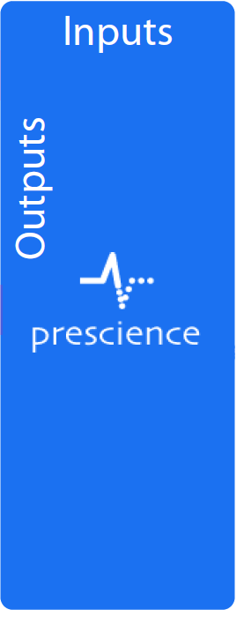
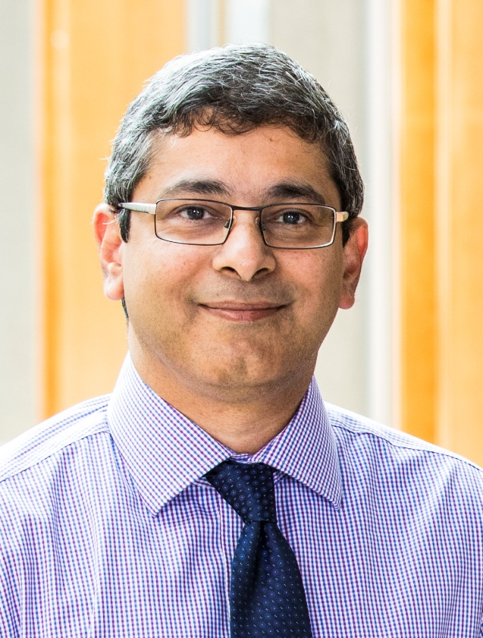

Prescience predicts hypoxemia and explains why
Training data
Anesthesia Information Management System (AIMS) data
50,000 surgeries from UW Medical Center and Harborview Medical Center
Anesthesiology & Pain Medicine
Bala Nair Jerry Kim
Notes:
It takes as input 20+ static features (including surgical procedure, age, weight, ASA physical status, diagnoses code, etc),
and 45 dynamic features (which include real-time, minute-by-minute information from patient monitors, such as heart rate, blood oxygen levels, and more).
Then, it makes a real time prediction in a form of a numeric representation of risk (e.g., 2.4 odds ratio) of hypoxemia within the next 5 minutes.
Prescience’s key feature is the ability to explain why a prediction was made – in this example, it shows the risk is due to the patient’s BMI, current tidal volume, and pulse rate. These explanations can be clinically meaningful because some factors may be modifiable and result in clinical changes mitigating that risk.
So, how did we build this system? For any ML model, we first need the training data.
Our collaborators, Bala and Jerry, acquired the AIMS data of 50,000 procedures from UW Medical Center and Harborview Medical Center.
%% Significant progress has been made recently integrating predictive machine learning solutions into medical care (9–12), but, accurately and intuitively conveying to doctors why a prediction was made remains a key challenge.
%% For example, a numeric representation of risk (e.g., 2.4 odds ratio) is useful. This prediction was made at some time point based on 20+ static features and 45 dynamic features.
%% However, a more detailed presentation that shows the risk is due to the patient’s BMI, current tidal volume, and pulse rate is more clinically meaningful since some factors may be modifiable and result in clinical changes mitigating that risk.
Tidal volume (i.e., volume of gas exhaled per breath)
SpO2 (blood oxygen concentration)
The Prescience prediction model was trained based on 50,000 surgeries in the AIMS data, consisting of
high fidelity real-time data – such as time series data from patient monitors and anesthesia machines, bolus and infusion medications, input and output fluid totals, laboratory results, templated and free text descriptions of anesthesia techniques and management
static data – such as American Society for Anesthesiology (ASA) physical status, surgical procedure, diagnoses codes, as well as patient demographic information such as age, sex, smoking status, height and weight.
[[Real-time data (45 variables): e.g., time series data from patient monitors, etc.]]
[[Static data (+20 variables): e.g., ASA physical status, surgical procedure, diagnoses codes, etc., as well as patient demographical information]] [[We extracted 3,905 real-time and static features.]]
We trained a gradient boosting machine (GBM) model. We will see later why we chose this particular prediction model.
To ensure that there was no bias towards the final test set, the test data was initially compressed and left compressed until method development was completed.
We excluded cases (heart transplant, lung transplant, tracheostomy, and coronary artery bypass surgeries) in which SpO2 and other hemodynamic parameters can be significantly affected by non-physiological measurements such as during cardiopulmonary bypass.
Hypoxemia (SpO2 < 90)
Hypotension (Mean arterial pressure < 60)
Hypocapnia (End-tidal CO2 < 35)
SBP < 90 for all
SBP <90 for under 55 yrs and <110 between 55 and over
MAP <60
Training and testing
We trained a gradient boosting machine (GBM) model.
42,420 procedures for training, 5,057 for testing (comparing across different prediction models) & 5,649 procedures for final validation
8,087,476 time points for training & 1,053,629 for validation

Slide 9
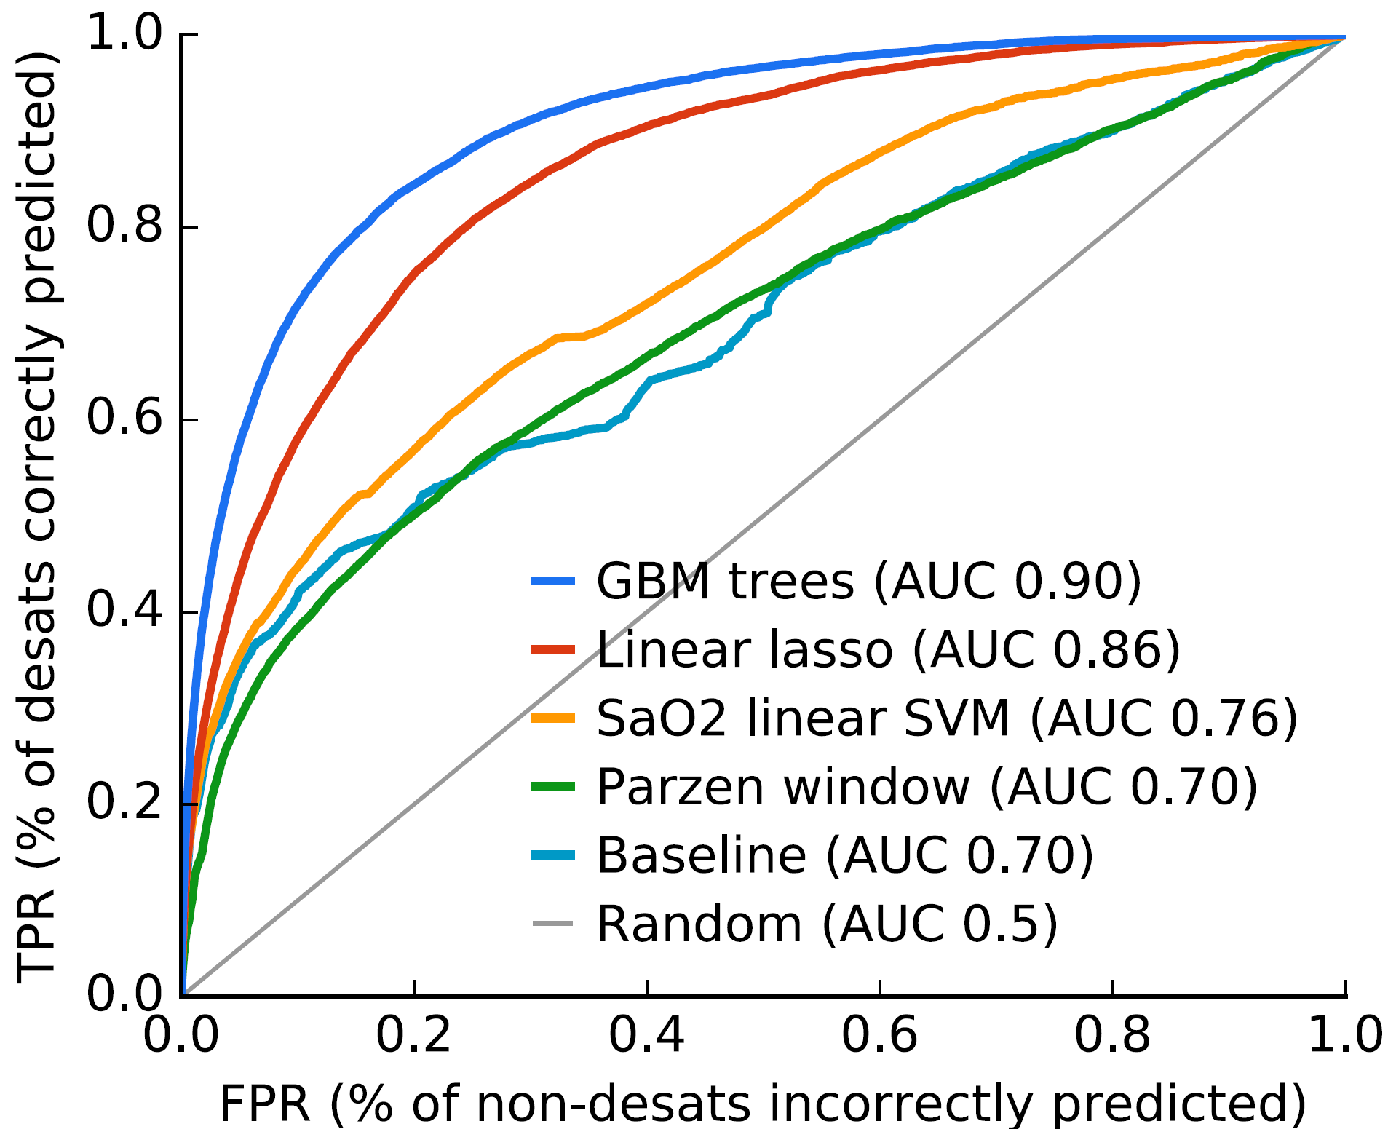
Different prediction models result in different prediction performance
Scott
When FPR=0.1, TPR changes from 0.58 to 0.73.
Receiver operating characteristic (ROC) curve from 10-fold cross validation tests.
Simple vs. complex models
Black Box
X₁
X₂
:
X_{p}
-
-
-
?
Complex model f (.)
Y
X: Features
Y: Outcome
X₁
X₂
:
X_{p}
-
-
-
w₁
w₂
Generalized linear model
?
Y
w_{p}
Notes:
Using these training data,
my PhD student Scott learned various kinds of prediction models and measured each model’s prediction performance on new, held-out test data as measured by the ROC curve, (the most common evaluation metric for prediction problems.)
We had to choose the best performing model in terms of the accuracy.
We found that the two best performing models are:
Linear regression model which is a simple model that is very interpretable (weights tell us which features are important)
GBM, a decision tree ensemble method, representing a complex model which is often considered to be a black box.
And, as you can see the tree ensemble model is significantly better than the linear model.
%% These two models show very different performance.
When FPR is set to be 0.1, TPR changes from 0.58 to 0.73 when you use a complex, black box model (25% increase in TPR)

Slide 10



Our solution is to make a prediction with explanations
Eliminating the accuracy vs. interpretability tradeoff ⇨ Broader applicability of ML to medicine
Scott
Accuracy vs. interpretability
Simple models often lead to lower performance.
Complex models are often considered to be a black box.
Linear model
Complex model f (.)
Our approach, SHAP
X: Features
Y: Outcome
Black Box
For a particular prediction
-
-
-
w₁
w₂
-
-
-
-
-
-
$φ_{1}(f,x)$
X₁
X₂
:
X_{p}
?
X₁
X₂
:
X_{p}
?
X₁
X₂
:
X_{p}
Y
Y
Y
w_{p}
$φ_{p}(f,x)$
SHAP can estimate feature importance for a particular prediction for any model.
Scott Lundberg and Su-In Lee. A Unified Approach to Interpreting Model Predictions. NIPS (2017) Oral presentation (top 1%) NIPS workshop on Interpretable ML (2016) – Best paper award
Notes:
Actually, we ML researchers are familiar with this situation – the tradeoff between accuracy and interpretability.
With large modern datasets the best accuracy is often achieved by complex models even experts struggle to interpret.
To resolve this challenge, we developed a new ML technique to estimate each feature’s importance for a particular prediction made on a particular patient.
SHAP is a general ML framework that can be applied to any model (tree ensembles or deep models). It has strong theoretical properties. It was selected for oral presentation at NIPS last year; it’s one of the two top conferences in ML. It was the only oral given by a UW researcher. It’s a very rigorous, theoretically well grounded method.
The most exciting aspect of SHAP to us is that its ability to provide simple explanations of predictions from arbitrarily complex models eliminates the typical accuracy vs. interpretability tradeoff.
This would allow broader applicability of machine learning to medicine.

Slide 11
How exactly can we estimate feature importance? – SHapley Additive exPlanation (SHAP) values
Scott
Why?!
chance John will have repayment problems
model
55%
No loan
John, a bank customer
Why?!
AI magic!
Notes:
So, how exactly do we estimate feature importance?
To show that, Let’s consider a simple, intuitive example. This is John, a typical bank customer. Like many consumers today, when he applies for a loan, his information is sent through a predictive model XX.
This model is designed to calculate the risk that John will have repayment problems, XX which, unfortunately for John, is 55%. And the bank declines his loan application XX.
A natural first question John has XX is “Why?” Again, AI magic.
%%The bank XX also want to know why, because these are key business decisions. But unfortunately for the data scientist that built this model XX, she used a complex model and so these questions are hard to answer XX …. XX

Slide 12

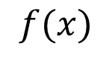
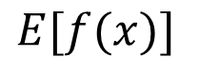
How exactly can we estimate feature importance? — SHapley Additive exPlanation (SHAP) values
Scott
Base rate
Prediction for John
20%
55%
$$0$$
$$E[f(x)]$$
$$f(x)$$
How did we get here?
Notes:
To explain his denial it is important to start with the base rate of loan repayment problems XX, denoted here by the expected value of the model’s output.
To explain John's risk XX, we need to explain how we got from the base rate XX, to his risk of 55%. How did we get there? XX

Slide 13
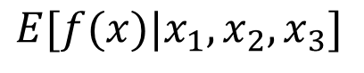
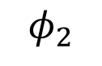
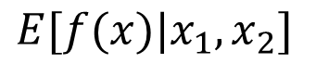
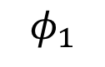
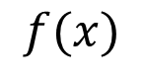
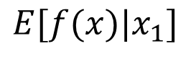
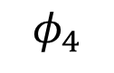
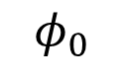
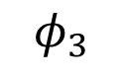
How exactly can we estimate feature importance? — SHapley Additive exPlanation (SHAP) values
Scott
20%
35%
55%
70%
90%
$$0$$
$$E[f(x)]$$
$$E[f(x)|x_{1}]$$
$$f(x)$$
$$E[f(x)|x_{1},x_{2}]$$
$$E[f(x)|x_{1},x_{2},x_{3}]$$
$$φ_{3}$$
$$φ_{0}$$
$$φ_{2}$$
$$φ_{1}$$
Day trader
Open accounts = 1
Base rate
$$φ_{4}$$
Age = 20
Married
Notes:
To do this we start at the expected value of the model output, and then condition on a single feature XX, John's age. Since this increases John's risk by 15% we attribute that increase to John's age.
XX Next we condition on John's occupation, which is not the most stable, and again attribute the change in expected model output to his occupation as a day trader.
If we repeat this for his open accounts XX and marital status XX we end up conditioning on all the features and so arrive at 55% of the model, John’s predicted risk. XX

Slide 14
How exactly can we estimate feature importance? — SHapley Additive exPlanation (SHAP) values
Scott
The order matters!
SHAP values result from averaging over all N! possible orderings
They are the only solution that satisfies three important properties
We need to develop efficient methods to estimate or compute exact SHAP values.
$$0$$
$$E[f(x)]$$
$$f(x)$$
$$φ_{3}$$
$$φ_{0}$$
$$φ_{2}$$
$$φ_{1}$$
Day trader
Open accounts = 1
Base rate
$$φ_{4}$$
Age = 20
Married
Scott Lundberg and Su-In Lee. A Unified Approach to Interpreting Model Predictions. NIPS (2017) Oral presentation (top 1%) NIPS workshop on Interpretable ML (2016) – Best paper award
Notes:
It is important that in this process the order matters! (if this a nonlinear model.)
For example, the impact of John being a day trader, it could be particularly bad if you are a young day trader. It means that the impact of Day trader could be large if you already know that he is young. Which means if we reversed the order it could be that age is more important and day trader shrinks.
XX SHAP values, our method, tries to average these attributions over all N! possible orderings.
We showed in our paper that these SHAP values are the only possible values which maintain three important properties. These properties make any comparison among features in terms of their importance values meaningful.
So it’s great, but of course this is not how we want to actually compute the values. XX (all possible orderings?)
Further research needs to be done to develop efficient ML algorithms to compute these SHAP values.

Slide 15
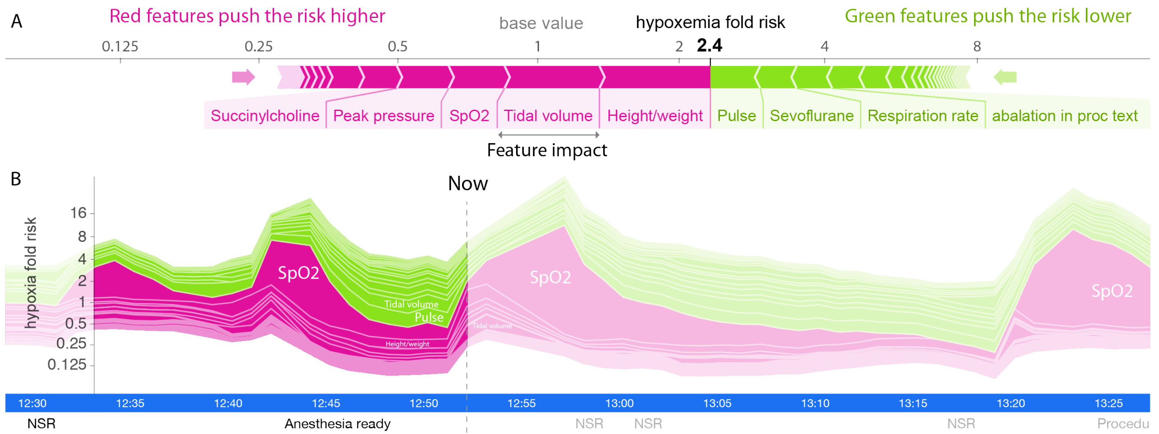
Prescience efficiently computes SHAP values on a prediction made on a single time point for a particular patient.
Scott
Notes:
Now, let’s return to Prescience.
Prescience outputs the risk prediction and its explanations which show a set of features that increased (purple-colored) and decreased (green-colored) the risk.
The plot at the bottom is equivalent to rotating the feature explanation at a certain time point by 90 degrees and then stacking the explanations for each time point horizontally.
We can see from the risk trend that the large increase in risk at the current time was driven by ‘Tidal volume’, meaning a drop in the patient’s tidal volume. (i.e., volume of gas exhaled per breath)
%%The future SpO2 (blood oxygen concentration) measurements confirm that the patient did indeed progress to hypoxemia (i.e., SpO2 ≤ 92).
%% Not only does Prescience alert anesthesiologists when a patient’s risk for hypoxemia is high, but also provides information on the factors and their relative contributions driving the risk. This
informed risk prediction enables anesthesiologists to plan an appropriate course of action to avoid hypoxemia.
% We developed an efficient, theoretically justified machine learning technique to estimate the importance of each feature on a prediction made for a single patient, which drives real-time explanations (Figure 3) for the Prescience model

Slide 16
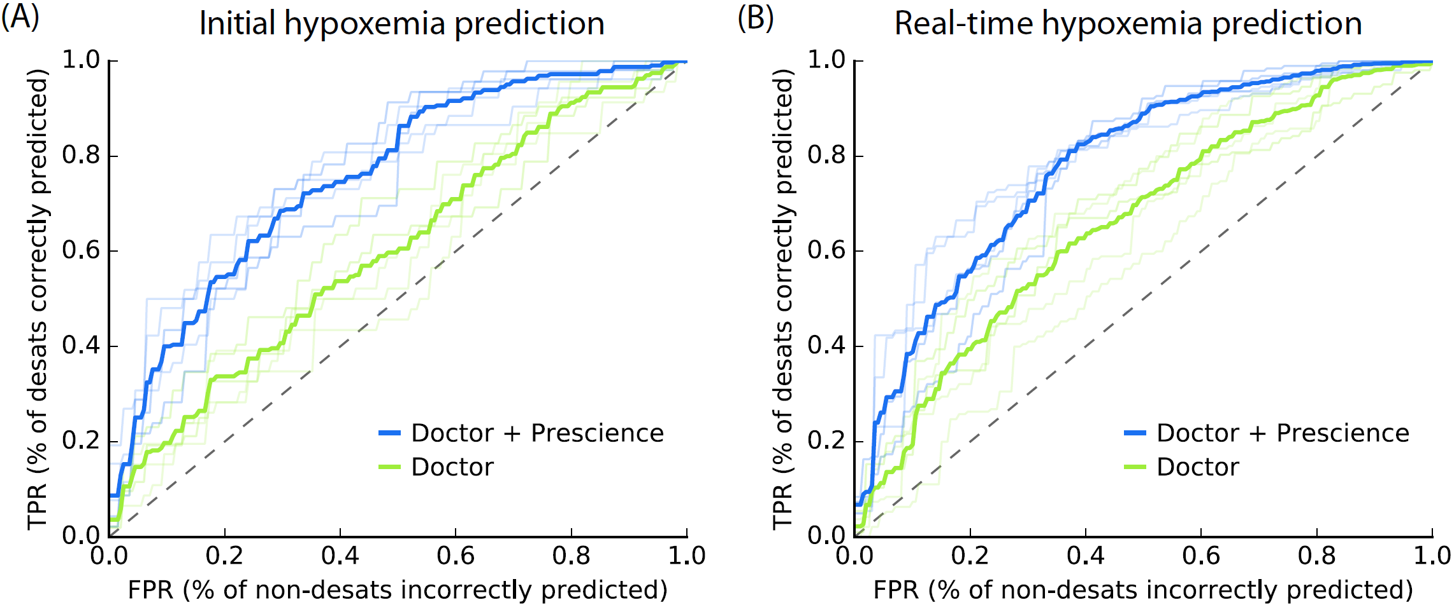
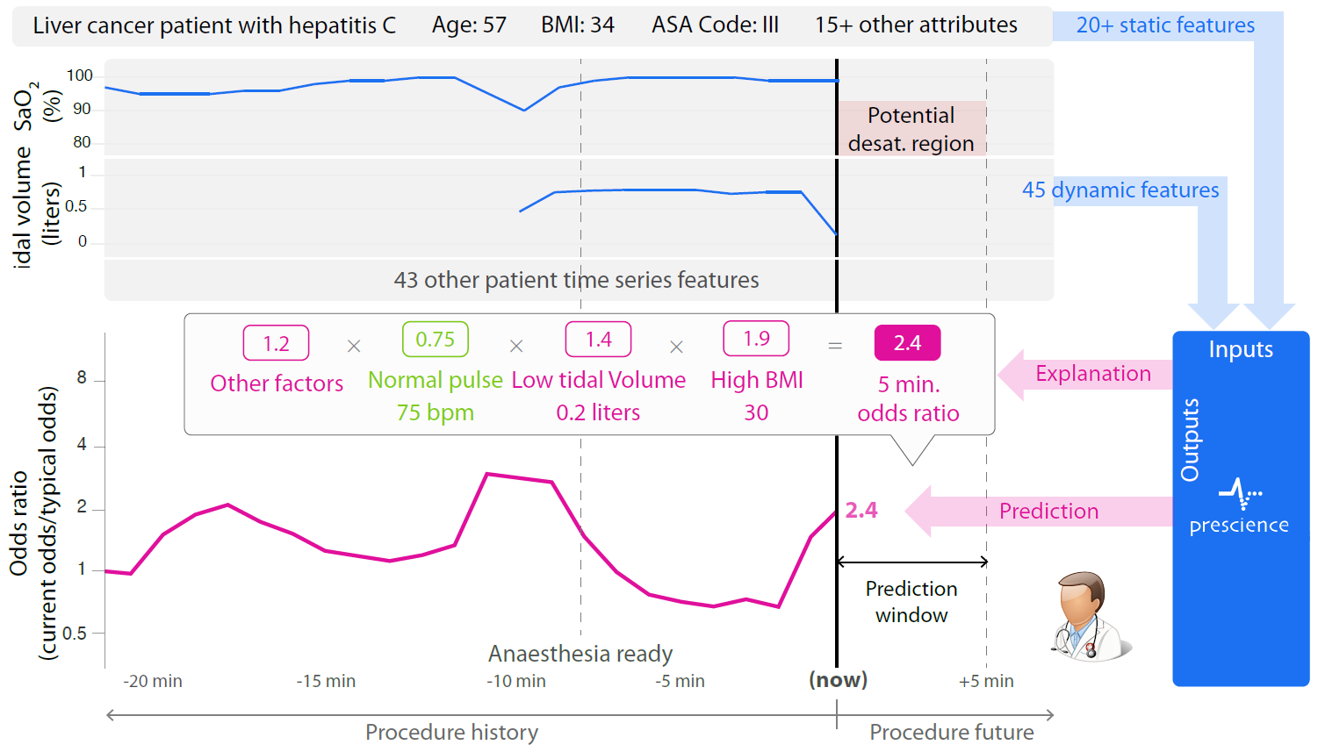
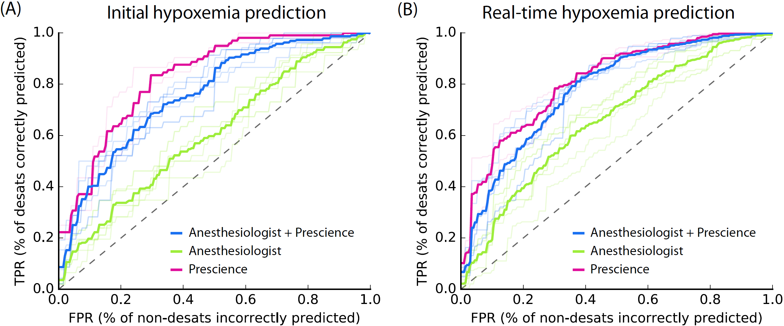
Prescience improves anesthesiologist’s ability to predict hypoxemia
Scott
We replayed prerecorded surgery data in a web-based visualization to 5 anesthesiologists.
Each anesthesiologist provided a relative risk of hypoxemia for ~270 cases without or with the aid of Prescience.
If anesthesiologists currently anticipate 15% of events, then with Prescience assistance they could anticipate 31% of events
Notes:
To test the potential of Prescience to aid hypoxemia prediction we replayed prerecorded surgery data from test data in a web-based visualization to five practicing anesthesiologists.
Each anesthesiologist provided a relative risk of hypoxemia as compared to a normal acceptable risk for ~270 cases.
These relative risks were used to compute the standard ROC curves which were then averaged across 5 anesthesiologists. (Standard ROC curves were averaged across 5 anesthesiologists.)
Here is the result.
The prediction accuracy of anesthesiologists markedly improved when they were given Prescience’s risk prediction and its explanations in addition to the original procedure data.
The results suggest that if anesthesiologists currently anticipate 15% of events, then with Prescience assistance they could anticipate 30% of events
This suggests that Prescience can improve anesthesiologists’ assessment of future risk and their ability to proactively anticipate hypoxemia events.
(or an estimated additional 2.4 million annually in the US, a large portion of which may be preventable because they are attributable to modifiable factors.)
% For each prediction task, anesthesiologists were asked to provide a relative risk of hypoxemia as compared to a normal acceptable risk, for example, 0.01 for 1/100th the normal risk or 3.4 for 3.4 times the normal risk. These relative risks were then used to calculate standard receiver operating curves averaged over five anesthesiologists as shown in Figure 2 which plots the true positive rate (i.e., % of desaturations correctly predicted) in the y-axis against the false positive rate (i.e., % of non-desaturations incorrectly predicted) in the x-axis.

Slide 17
Prescience improves anesthesiologist’s ability to predict hypoxemia
Scott
What if we just let Prescience predict the hypoxemia risk?
If anesthesiologists currently anticipate 15% of events, then Prescience alone could anticipate 43% of events
Notes:
[I thought I removed this slide for this talk.]
What happens if we just let Prescience predict hypoxemia?
Interestingly, the prediction performance of anesthesiologists with Prescience was slightly lower than direct predictions from Prescience.
[I wouldn’t add further comment on this result.]
This means that when the anesthesiologists adjust their risk estimate for a patient away from what Prescience originally predicted they are more likely to be wrong than right.

Slide 18
Interpretable ML can transform important areas of medicine
Prediction & decision support systems in hospitals
Make interpretable predictions from complex models.
Cancer precision medicine a
Learn interpretable feature representations.
Alzheimer’s disease therapeutic target discovery
Integrate data sets for statistical power and interpretability.
General ML techniques
Data integration
Bedside applications
Basic science
Notes:
In the first part of the talk, I presented our SHAP method that enables individualized explanations.
SHAP with efficient computational methods led to clinical problems on guiding clinical actions (ER), identifying individualized risk factors (kidney), identifying subgroups of patients with similar explanations etc.
Let’s turn to the second topic – cancer precision medicine.

Slide 19
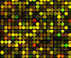
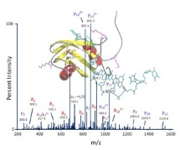
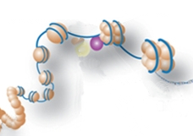
Precision medicine in cancer treatment
Interpretable ML system
Predicted response
to 160 drugs
Acute myeloid leukemia (AML)
Cancer of the blood and bone marrow cells
5 year survival rate: 26%
Chemotherapy
>100 anti-cancer drugs (62 FDA approved)
Standard therapy is not personalized.
Patient X
Molecular features
& Why?
Mitoxantrone
Sorafenib
Daunorubicin
:
Topo II activated
FLT3 mutated & highly expressed
:
Prediction model informed by prior knowledge & data
mRNA
expression
DNA sequence
protein
expression
epigenome
:
AGCTACGTGCTACATCTATCTATCTATTCTATCTATCTATCATTTCTATCTATCTTCTATCTTACACCCCCAGGGCACCCCCCAAATCTTCTCTATCTAC…
Individualized feature importance estimation
Best drug combinations for patient X
Mitoxantrone + Etoposide
+ Ara-C
:
viability
concentration
Lee*, Celik*, et al. (2018)
Nature Communications
Notes:
Say that there is a patient X has AML, an aggressive blood cancer.
Like other cancers, there are many anti-cancer drugs this patient can be treated with.
However, standard cancer therapy is not personalized.
Our goal is to build a ML-based system that takes molecular profile of a patient, predict the response to a large number of anti-cancer drugs, and gives us the explanation of the predictions and reasoning.
So that we can select the best combination of drugs for that particular patient.

Slide 20
Learn interpretable feature representation
Patient X
Molecular features
Interpretable ML system
Predicted response
to 160 drugs
& Why?
mRNA
expression
DNA sequence
protein
expression
epigenome
:
Mitoxantrone
Sorafenib
Daunorubicin
:
Topo II activated
FLT3 mutated & highly expressed
:
Prediction model informed by prior knowledge & data
AGCTACGTGCTACATCTATCTATCTATTCTATCTATCTATCATTTCTATCTATCTTCTATCTTACACCCCCAGGGCACCCCCCAAATCTTCTCTATCTAC…
Personalized feature importance estimation
Best drug combinations for patient X
Mitoxantrone + Etoposide
+ Ara-C
:
viability
concentration
Notes:
Let’s first talk about how to learn a robust prediction model from high-dimensional molecular data, by learning interpretable features.
% As you will see soon, it is important to use a new feature selection criteria concerned with interpretability.

Slide 21
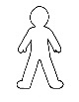
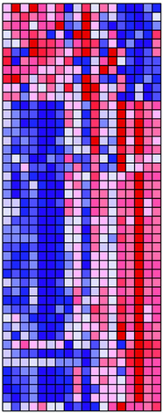

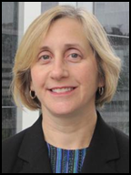

A naïve solution: Supervised learning approach
Safiye
Training Data
Samples: 200 AML patients
Test Data
Consistency in association ?
…
Prediction Model
Each patient
X
X_{F}
X_{H}
X_{G}
X_{i}
Molecular profiling
20,000 genes
X: Feature
variables
Validation data
mRNA
expression
DNA sequence
protein
expression
X_{D}
X_{C}
X_{B}
X_{A}
X_{E}
Hematology
Drs. Pam Becker Tony Blau
Expression markers for Y
Drug sensitivity profiling
Y
viability
Y
160 drugs
Y₂
Y: Outcome
variables
?
Y₃
concentration
Notes:
This problem can be seen as a classic supervised learning problem.
Our collaborators in Hematology got us the training data, which consists of feature variables X (here, gene expression levels) and outcome variables Y (in-vitro sensitivity measures for 160 drugs) on a set of samples (200 primary AML patients specimens),
Using these training data, we can learn a prediction model for each drug so we can predict the drug sensitivity of a new patient based on his or her features.
We first evaluated the simplest form of supervised learning approach by measuring how many of the significant gene-drug pairwise associations observed in the training data are replicated in an independent validation data set.

Slide 22
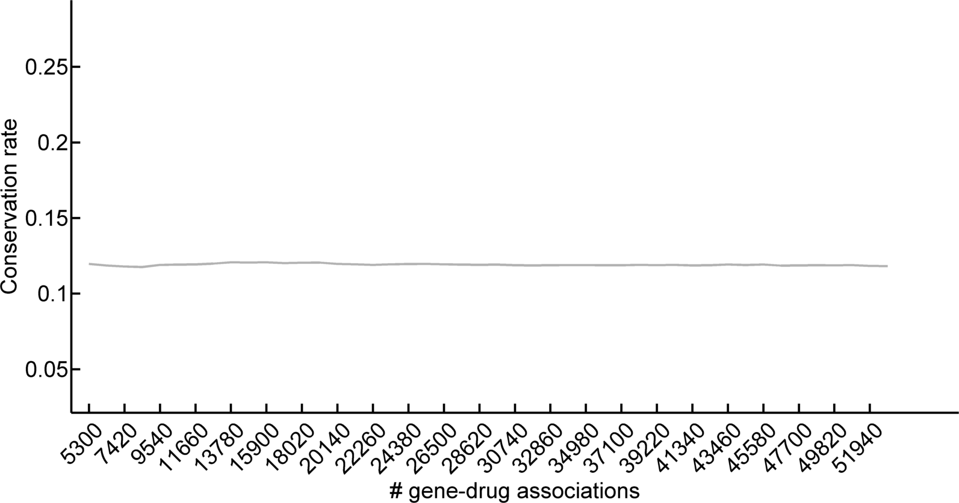
Only a small fraction of significant gene-drug associations are replicated in validation data
Safiye
Validation data
X
Consistency rate
(True Discovery Rate)
Number of replicated associations ( )
Number of significant associations ( or )
=
X
X
X
Only ~18% are replicated in an independent validation set
X
X
X
A conventional statistical method suggests to consider the gene-drug associations up to here.
X
consistency rate
X
ordered list of gene-drug pairs based on degrees of associations
Y₁
Y₂
Y₃
200 400 600 800 1000 1200 1400 1600 1800 2000 2200
Lee*, Celik*, et al. (2018)
Nature Communications
average # associations per drug to follow up on
Notes:
My student, Safiye, computed the consistency rate, defined as # associations replicated in an independent validation dataset divided by the number of significant associations, which can be interpreted as true discovery rate.
We ordered the list of …
And, we got pretty depressing result that says that only …

Slide 23
Supervised learning approach has serious drawbacks
Safiye
AML patients
Observed Association
High-dimensionality
# of (genes x drugs) ≫ # of patients
Confusion caused by
Hidden variables (e.g., batch effect, unknown disease subtype)
Correlation with a true marker
Our solution – Unsupervised feature learning to select genes likely to explain associations.
X
X
X
X
20K genes
disease driver
X
X
X
X
H
X
X
X
X
Y₁
160 drugs
Y₂
Y₂
Notes:
We know that poor replication is common in this kind of analysis, for several reasons.
First is high-dimensionality. We simply don’t have enough samples to ensure that the identified associations are not false positives.
Second, confounders.
Hidden variables that can predict drug response better and can explain some of the gene-drug associations.
Disease heterogeneity contributes to the poor replication.
We cannot fully rely on the statistical association observed in the training data.
We need an unsupervised
%% Poor replication is an important issue in genetic association studies. In particular, there has been poor replication among studies
This is a well-known problem
Disease heterogeneity
Confounders
False positives (high-dimensionality)
While identifying the gene-drug associations with the smallest association p-values in a large study is one way to prioritize genes as biomarkers for response to drug therapy, there are many reasons why drug response could be associated with gene expression that have nothing to do with the underlying biological mechanism of drug response. These associations could be driven by biological confounders (e.g. disease sub-types or disease heterogeneity), experimental confounders (sample ascertainment), or even technical confounders (e.g. batch effects) and often do not replicate

Slide 24

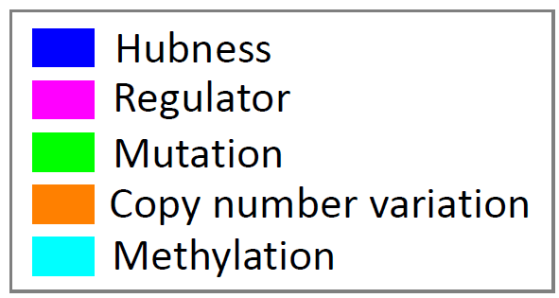
MERGE: Machine learning approach to integrate big data to select robust expression markers
Safiye
AML patients
MERGE AI algorithm
MERGE features
Publicly available AML data
Study 1
X
…
Study 3
X
MERGE weights
Study 2
X
…
mRNA
expression
Let’s focus on the explainable associations.
X
20K genes
X
Weighted contribution
miRNA
DNA methylation
X
X
20,000 genes
X
X
protein
expression
X
X
X
X
X
X
For each gene G,
how frequently G is Mutated in AML
G’s Expression hubness
whether G is a Regulator
G’s Genomic CNV in AML
G’s mEthylation status in AML
X
Y₁
MERGE score
M E R G E
160 drugs
Y₂
Y₂
Notes:
An alternative solution is to integrate publicly available high-throughput data sets generated by multiple studies.
We extract gene-level features that tell us how likely the gene drives the disease progression so we can be confidently use them as expression markers for drug response.
…
We named these gene-level features, the MERGE features. Each letter represents a property of a gene that can indicate its potential to be a reliable marker for drug response.
What would M mean.
Then, our MERGE algorithm combines this information to learn the MERGE score such that this score can explain gene-drug associations. You want to focus on only explainable associations

Slide 25
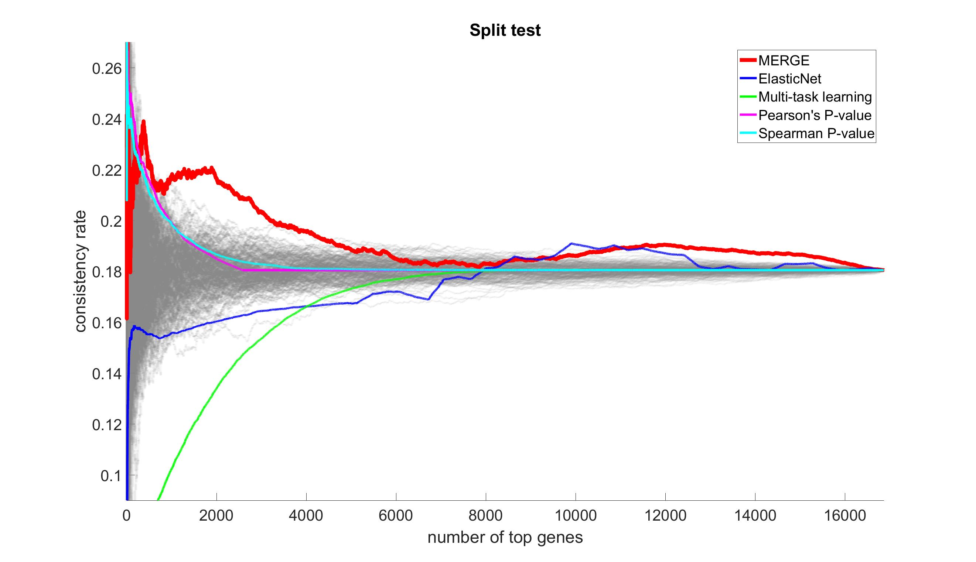
MERGE outperforms its competitors on consistency rate and drug sensitivity prediction accuracy
Safiye
20% more chance to detect true positive markers!
Lee*, Celik*, et al. (2018)
Nature Communications
Notes:
When you use MERGE the consistency rate significantly improves in the important region, and it’s better than four other methods.
Its performance of drug response prediction is also better than 3 alternative approaches.

Slide 26
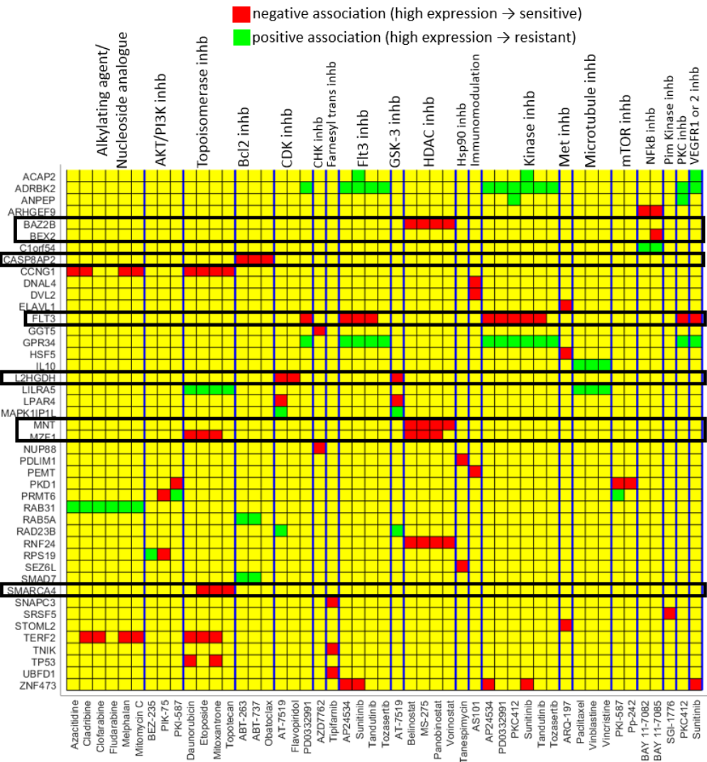
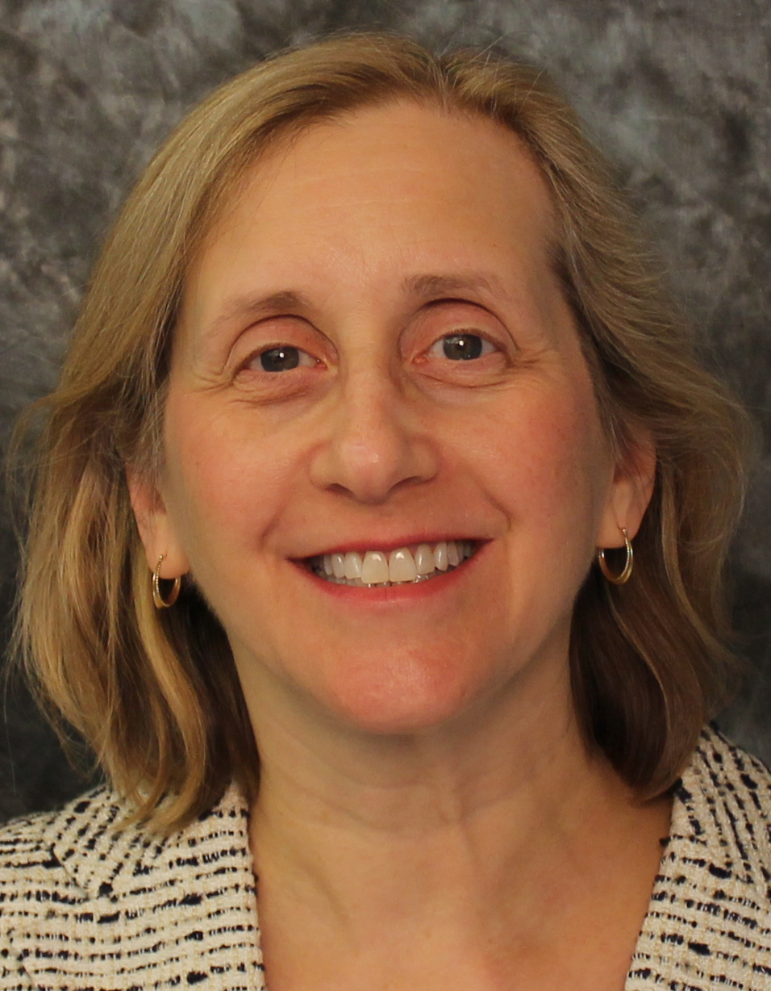
Example novel gene-drug associations captured by the learned marker potential
Safiye
Learning associations
High expression of SMARCA4 is associated with increased sensitivity of mitoxantrone and etoposide
Clinical importance:
Mitoxantrone – included in nearly all first line AML treatment
Etiposide, mitoxantrone – 2 of the 3 drugs used in the MEC regimen, a common therapy for relapsed AML
This finding can have immediate impact.
SMARCA4 would not have been captured purely based on the degrees of associations
SMARCA4 is a significant expression hub.
Topoisomerase inhibitors
g
g
g
FLT3
g
g
g
SMARCA4
g
g
SMARCA4
D₁
D₂
Hematology
Dr. Pamela Becker
D₃
Notes:
So, many of the gene-drug pairs identified by MERGE made sense based on known AML biology.
One of the novel findings was that:
This finding can potentially be very important because these two drugs are used in today’s AML treatment.

Slide 27
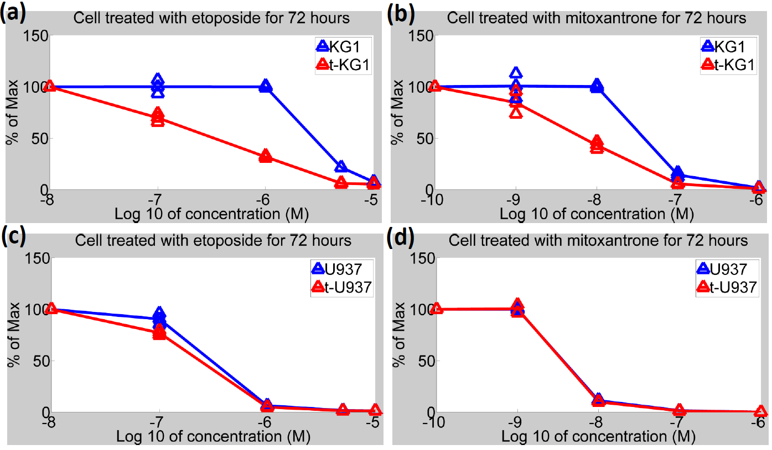
Experimental validation – SMARCA4 over-expression drives sensitivity to etoposide & mitoxantrone
Hematology
Dr. Pamela Becker
We considered an AML cell line
KG-1: low SMARCA4
Transfected KG-1: high
Another AML cell line
U937: high SMARCA4
Transfected U937: high
Etoposide
Mitoxantrone
Overexpressing SMARCA4 induced sensitivity!
Notes:
Our collaborator, Pam Becker in Hematology, was super motivated to experimentally validate this hypothesis in her lab.
They picked an AML cell line that shows …
%% Transfected KG1 cells overexpressing SMARCA4
%% Whereas in KG-1 that originally showed very low SMARCA4 expression
==========================================
Western blotting analyses of SMARCA4 protein expression
Western blotting of control & transfected of AML cell lines: HL60, KG-1, MV411 and U937.
Quantifications of SMARCA4 protein expression pattern of above AML cell lines.

Slide 28
Interpretable ML can transform important areas of medicine
Prediction & decision support systems in hospitals
Make interpretable predictions from complex models.
Cancer precision medicine a
Learn interpretable feature representations.
Alzheimer’s disease therapeutic target discovery
Integrate data sets for statistical power and interpretability.
General ML techniques
Data integration
Bedside applications
Basic science
Notes:
In the second part of the talk, we talked about choosing drug.
Personalized drug recommendations are only possible when we have drugs to choose from, which is unfortunately not true for the case of AD.
%% First, developing prediction and recommendation systems in hospitals;
Second, enabling personalized drug selection for individual cancer patients based on their expression data;
Finally, we are focusing on much more poorly understood disease, Alzheimer’s disease, for which there aren’t any drugs at all, so the main goal is to leverage all of the data to find a molecular basis common to general AD, which will inform drug discovery.

Slide 29
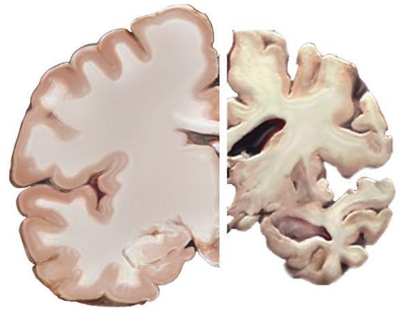
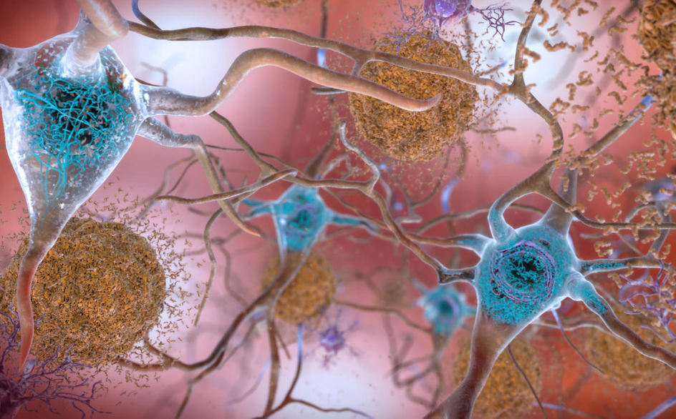
Alzheimer’s disease (AD)
6th most common cause of death in the US
No effective therapy exists to delay or prevent onset of progression
Only disease that cannot be cured or even slowed down among the top 10 deadly diseases in the US
Neuritic plaques and neurofibrillary tangles are neuropathological hallmarks of AD
Healthy brain
Severe AD
Amyloid-β
(Aβ)
Tau
Notes:
AD is the 6th leading cause of death and the only disease (among the top 10 deadly diseases in the US) that has no cure, no prevention, and no treatment to reverse or halt its progression.
Critical barriers include the lack of understanding of the molecular basis for AD’s neuropathological hallmarks, amyloid plaques and neurofibrillary tangles, whose building blocks are Amyloid-β (Aβ) and tau, respectively.
We (biologists) often learn about the molecular basis for a phenotype, by using gene expression and phenotype data. In this case, neuropathological phenotype.
%Currently, there is no effective treatment for Alzheimer’s disease (AD). Critical barriers include the lack of understanding of the molecular basis for AD’s neuropathological hallmarks, amyloid plaques and neurofibrillary tangles, whose building blocks are Amyloid-β (Aβ) and tau, respectively. Biologists are now gathering gene expression data (NIA’s AMP-AD project) and Aβ and tau measures from human brain. The current approach attempts to select a set of features X (gene expression levels) that best predict a phenotype Y (Aβ or tau level). Selected features, molecular markers, can help determine the molecular basis for plaques and tangles.

Slide 30
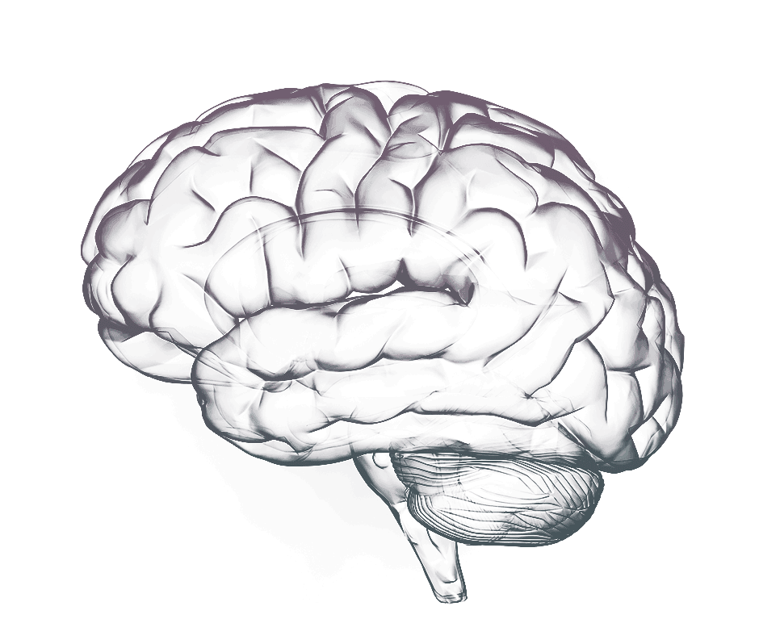
What do we need to identify the molecular basis of Aβ or tau level?
INPUT
We need expression and phenotype data.
Find genes relevant to the phenotype
Statistical association between the phenotype and each gene expression level
Phenotype
(Aβ level)
Gene expression levels
…
brain
brain
brain
brain
Samples
Notes:
Do we have a lot of data like this?

Slide 31
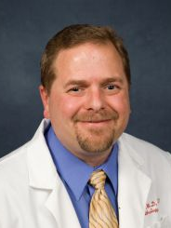
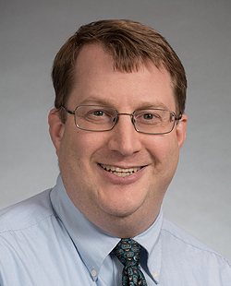

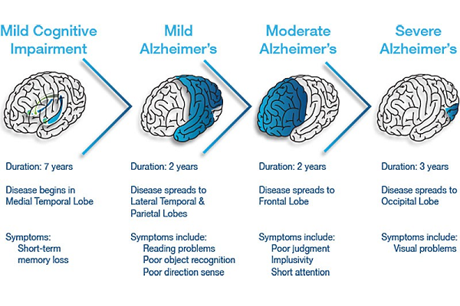
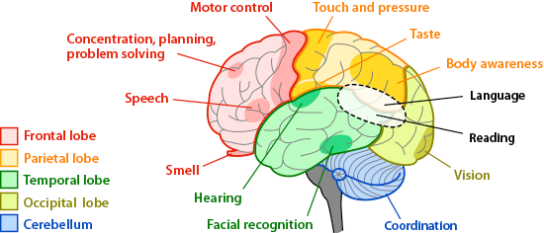
AD expression data is limited and discrepancies across studies post challenges
Safiye
Expression and neuropathology measured in 1,742 samples from 9 brain regions.
Region acronym | Brain region | Sample size
ACT-TCx | Temporal cortex | 85
ACT-PCx | Parietal cortex | 79
ACT-HIP | Hippocampus | 80
ACT-FWM | Forebrain white matter | 81
ROSMAP-DPFCx | Dorsolateral prefrontal cortex | 538
MSBB-BM10 | Brodmann area 10 (frontopolar cortex) | 244
MSBB-BM36 | Brodmann area 36 (ectorhinal cortex) | 200
MSBB-BM44 | Brodmann area 44 (opercular part of the inferior frontal gyrus) | 208
MSBB-BM22 | Brodmann area 22 (posterior part of the first temporal gyrus) | 227
Different brain regions have different cell type compositions, functions, and relevance to AD.
Different tools and methods are used to quantify neuropathology
Different subject compositions or experimental procedures (batch effects, and confounders)
We need a powerful ML algorithm that can incorporate reliable prior knowledge to help us focus on true signals.
Neuropathology
Internal Medicine
AD Research Center
Dirk Keene Paul Crane Joey Mukherjee
Notes:
My student, Safiye, started with collecting expression and neuropathology data measuring Abeta and Tau from various parts of the brain in collaboration with Dirk, Paul, and Joey.
We ended up finding data from 3 AD studies. (Only three RNA-Seq studies: ACT, ROSMAP, and MSBB.)
To our knowledge, the largest expression meta-analysis for AD.
However, analyzing these data will be very challenging because
Message: We need powerful approach to reduce the effect of noise caused by discrepancies
ACT – Adult Changes in Thought (ACT) study.
ROSMAP – Religious Orders Study and Memory and Aging Project (ROS/MAP)
MSBB – Mount Sinai Brain Bank (MSBB) AD Cohort

Slide 32









EMBARKER (EMpowering Big datA with prioR Knowledge for Expression markeR discovery)
Safiye
$$β$$
INPUT
$$α$$
EMBARKER-M
EMBARKER
Top genes: 10 out of top 20 are Complex I genes (NDUF family)
NDUFA9
1
2
R
OUTPUT
Phenotype
(Aβ level)
NDUFB5
$$α$$ (gene weights)
...
Top pathway: TCA cycle and respiratory electron transport
Learned study weights w
NDUFB8
Gene expression levels
1
2
...
R
Hypothesis based on top genes & pathways: Complex I genes have a role in tolerance to Aβ toxicity
$β$
Samples
Pathways
Pathways
(pathway weights)
Expression and phenotype data measured in samples from $R$ studies
674 REACTOME pathways from the current version of MSigDB C2
In vivo validation in a transgenic C. elegans model expressing Aβ
Safiye Celik, Josh C. Russell, Cezar R. Pestana, Ting-I Lee, Shubhabrata Mukherjee, Paul K. Crane, C. Dirk Keene, Jennifer F. Bobb, Matt Kaeberlein*, and Su-In Lee*. EMBARKER: A hierarchical Bayesian approach empowering big data with prior knowledge for expression marker discovery and its application to AD. Under Review
Notes:
What are they? It’s based on the pathway-gene membership information that tell us which genes belong to each pathway based on literature-based database, such as Reactome.
Our EMBARKER algorithm is a hierarchical Bayesian model that gives us both of gene-level and pathway-level relevance measure to the phenotype.
The idea is that genes that belong to the same pathway are likely to have similar relevance values to each other, and the hierarchical Bayesian model will encourage that. Also, the pathway-level relevance will improve the interpretability.
We developed EMBARKER-M method that can handle multiple datasets like we have for our AD data analysis.
%% NDUFA9 – top 2
This consistency led us to the hypothesis that
Using the transgenic C. elegans (GMC101) model expressing Aβ in its body wall muscle cells. It’s age-associated aggregation, which results in rapid onset of age-associated paralysis.
So, at a certain age, this worm will be paralyzed.
%This transgenic worm line displays an age-associated aggregation of human Ab₁₋₄₂ peptide, which results in rapid onset of age-associated paralysis.
%% The top gene from EMBARKER ranking with a worm ortholog was NDUFA9, which encodes the alpha subcomplex subunit 9 of Complex I of the mitochondrial electron transport chain (mETC)
%% We propose EMBARKER, a probabilistic model-based framework to identify robust expression markers for a phenotype by leveraging growing availability of pathway information (i.e., gene-GeneSet membership) and datasets from multiple studies.
Distract the algorithm from noise by focusing more on this valid pathway information.

Slide 33




In vivo validation – Inhibition of mitochondrial complex I subunit NDUFA9 leads to tolerance to Aβ toxicity
Josh Russell
Matt Kaeberlein
If we knock down the worm homolog of NDUFA9, would we see delay in paralysis?
Paralysis assay using the WormBot in Kaeberlein lab
Control Treatment
144 experiments per run
Automated software
Time-lapse movies
Efficiency (2 min vs. 3.5 hr)
Ben Blue Jason Pitt
Pitt et al., unpublished
Notes:
The question is if you knock down the worm ortholog of NDUFA9, whether paralysis will be delayed. (worms will become less ill.) That will prove that the worm ortholog of NDUFA9 plays a role in inducing tolerance to Abeta toxicity. Could be AD drug target
Matt’s lab has a fantastic WormBot system. His lab can perform this kind of paralysis assay for many genes at the same time.
We used RNAi to reduce the expression of NDUFA9 homolog (Y53G8AL.2) and observed a significant delay in paralysis compared to control animals treated with empty vector (EV) RNAi.
So then, how would it actually look? Here is the idea.
%% What kind of worms? Abeta1-42 (GMC101) Y53G8AL.2
We perform a validation of the identified markers in vivo in a transgenic Caenorhabditis elegans model, which suggests mild inhibition of Complex I as a promising pharmacological avenue toward treating AD.
Experimental validation

Slide 34



In vivo validation – Inhibition of mitochondrial complex I subunit NDUFA9 leads to tolerance to Aβ toxicity
Josh Russell
Matt Kaeberlein
Control Treatment
144 experiments per run
Automated software
Time-lapse movies
Efficiency (2 min vs. 3.5 hr)
Ben Blue Jason Pitt
Pitt et al., unpublished
Notes:
As you can see as time goes, it becomes clear that worms under treatment move more lively.
Consistently with this graph.
Suppression of paralysis by knockdown of Y53G8AL.2 was comparable to RNAi knockdown of the insulin-like receptor gene daf-2, one of the strongest known suppressors of Aβ toxicity in worms.
It’s a pretty similar level of delay.

Slide 35



Knockdown of 12 other Complex I genes also robustly protected against Aβ toxicity
Josh Russell
Matt Kaeberlein
7 of top 10 (12 of top 20) EMBARKER-M genes are Complex I genes
Complex I inhibitors
capsaicin
***
EMBARKER-M pinpoints mitochondrial Complex I as a critical mediator of proteostasis and a promising pharmacological avenue toward treating AD
Notes:
In addition to NDUFA9, we found that 7 of top 10, and 12 of top 20 genes were Complex I genes.
We therefore hypothesized that Complex I may act as a key regulator of Aβ toxicity.
To test this hypothesis, we individually knocked down 12 additional C. elegans genes that encode homologs of human Complex I proteins in this Aβ₁₋₄₂ worms.
Strikingly, knockdown of any of these 12 additional genes significantly delayed paralysis, with several exceeding the effect of Y53G8AL.2.
So, our approach pinpointed mitochondrial Complex I as a critical mediator of Aβ proteostasis.
Is there a drug that inhibits complex I? Capsaicin is one of them. [Maybe we need to eat more peppers.]

Slide 36
New AI/ML techniques can enable new ways to treat patients and to make biological discoveries from data
Prediction & decision support systems in hospitals
Make interpretable predictions from complex models.
Cancer precision medicine a
Learn interpretable feature representations.
Alzheimer’s disease therapeutic target discovery
Integrate data sets for statistical power and interpretability.
General ML techniques
Data integration
Bedside applications
Basic science
SHAP, & Prescience
MERGE
EMBARKER
Notes:
In this talk, I presented our new interpretable ML techniques [CLICK] SHAP and more,
And showed you how they can potentially change the way we treat patients and make biological discoveries from data.
I believe that these exemplify the importance of advancing AI and ML (they are not perfect) in order to generate high impact in medicine and biology, and for that we need to continue addressing the challenges we cannot address with existing ML tools.
%% New ML/AI techniques such as [CLICK] enable new ways to make biological discoveries from big data and new way to treat patients.
These ML techniques [CLICK] we developed are general frameworks and can be applied to many other diseases or even .
In all of these projects, instead of using off-the-shelf ML algorithms, we addressed challenges and created new methods
In this talk, I am going to show you how our new interpretable ML techniques (motivated by these questions) can potentially transform important areas of medicine.
First, developing prediction and recommendation systems in hospitals;
Second, enabling personalized drug selection for individual cancer patients based on their expression data;
Finally, we are focusing on much more poorly understood disease, Alzheimer’s disease, for which there aren’t any drugs at all, so the main goal is to leverage all of the data to find a molecular basis common to general AD, which will inform drug discovery.
The techniques we are developing are mostly general and can be applied to other problems (not domain specific).
Our research covers the spectrum from basic drug discovery for a poorly understood disease to very specific treatment recommendations for better understood diseases. (Also from basic science to bedside applications.)
Let’s talk about the first part.
[[spectrum]]
I think maybe a good distinction you can make is that the cancer stuff is aiming to leverage big data for personalized drug selection for individuals, whereas AD is so poorly understood that there aren't any drugs, so the main goal is to leverage all of the data to find a molecular basis common to general AD which will inform drug discovery. So your work covers the spectrum from basic drug discovery for a poorly understood disease to very specific treatment recommendations for better understood diseases.
[[when transitioning]]
also for your transition, you could say something like "personalized drug recommendations are only possible when we have drugs to choose from, which is unfortunately not true for the case of AD"
Second, real-time prediction of various adverse events during surgery. We showed that making interpretable predictions help anesthesiologists predict hypoxemia much better.
Finally, individualized risk factors for chronic kidney disease, which can lead to a new disease sub-classification system.
We will start with the precision oncology.

Slide 37





Lee Lab
Safiye Celik Scott Nao Ayse Dincer Nicasia Alex Yuan
Lundberg Hiranuma Beebe-Wang (MCB)
Hugh Chen Pascal Sturmfels Joe Janizek Gabe Erion Alex DeGrave
Notes:
my group’s effort to develop new ML techniques focused on interpretability applied to various problems in precision medicine.
My goal today is show you examples of how advancing ML can change the way doctors treat patients, saving lives, so hopefully some of you get interested working in this area.
Therefore, instead of delving into details of a particular ML algorithm, I will stay at a high level because you can always read our papers later.

Slide 38










Lee Lab
Pathology & neuropathology
Hematology
Funding supports
NIH NIA R01 (pending) (PI: Lee)
NIH NIGMS R35 (PI: Lee)
NIH NLM R21 (MPI)
NSF ABI Innovation (PI: Lee)
NSF CAREER (PI: Lee)
American Cancer Society (PI: Lee)
NSF ABI Innovation (PI: Lee) – completed
NIH NIA R21 (PI: Lee) – completed
Matt Kaeberlein Dirk Keene
Tony Blau Pamela Becker
Safiye Celik Scott Nao Ayse Dincer Nicasia Alex Yuan
Lundberg Hiranuma Beebe-Wang (MCB)
Internal Medicine
Alzheimer’s disease research center
Emergency Medicine
Hugh Chen Pascal Sturmfels Joe Janizek Gabe Erion Alex DeGrave
Nathan White
Paul Crane Joey Mukherjee
Anesthesiology & Pain Medicine
School of Dentistry
Kidney Research Institute
Institute for Protein Design
Monica Bala Nair Jerry Kim
Vavilala
Georgios Kotsakis
Jonathan Nisha Bansal Ronit Katz
Himmelfarb
David Baker Frank Dimaio
Notes:
I want to re-emphasize the importance of the active participation of medical investigators in AI research, to address these challenges together. (I hope to find more such people to work with us.)
And, I again thank my students, our collaborators, and funding sources. They support our research with different amounts of funding, but I really like all of them.
%% These projects are interdisciplinary.
So, it was very important to gather people from different fields to make this kind of research possible.
It is a collaborative project with the current and past members of my lab (mostly CSE), my the other department, and collaborators in various clinical departments.
I again want to thank
I want to re-emphasize the importance of being open to a new approach …
%% This work was done in collaboration with an incredibly strong and supportive group of medical investigators here at UW School of Medicine.
We cannot do anything without funding. They gave different amounts of funding but I like all of them.
Before I begin, I’d like to thank our medical collaborators for being such active participants in AI research, sometimes holding my hand to help us understand new diseases and biology and make sense of their data, our results, and our models, and exploring new problems with us. Their role was not just supplying us with patient data and asking us solve the problems.
One of the most important things in this line of work, which I hope you will see from my talk, is such a strong and supportive group of medical investigators who are willing to actively participate in AI research instead of being passive customers of machine learning.
[[One of the most important things in this line of work is the active participation of medical investigators in AI research instead of being passive customers of machine learning.]]
%% It’s truly a great honor to be here as a speaker, although I am not sure if I deserve the opportunity to give this lecture here today. Understanding human diseases and learning how to treat them take at least a decade of research for one disease. My group started to show that our new approach (data-driven, AI-driven approach) can be a promising direction toward future medical breakthrough someday. I want to take this opportunity to say one of the most important things in this line of work is a strong and supportive group of medical investigators who worked with people like us.

